Slide 1



W.S. (5)
This is (這是…) / These are (這些是…)
That is (那是…) / Those are (那些是…)

Slide 2
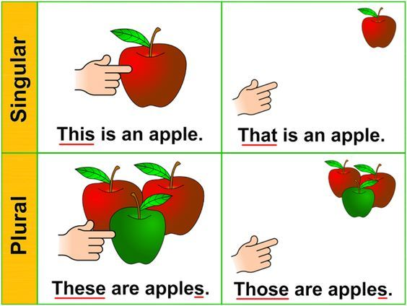
當我們表達或說明近距離的一個人或一件物件時，我們會用‘This is ... (這是…)’來表示。
* 所指的人或物的數量只有1,稱為Singular (單數)。

Slide 3
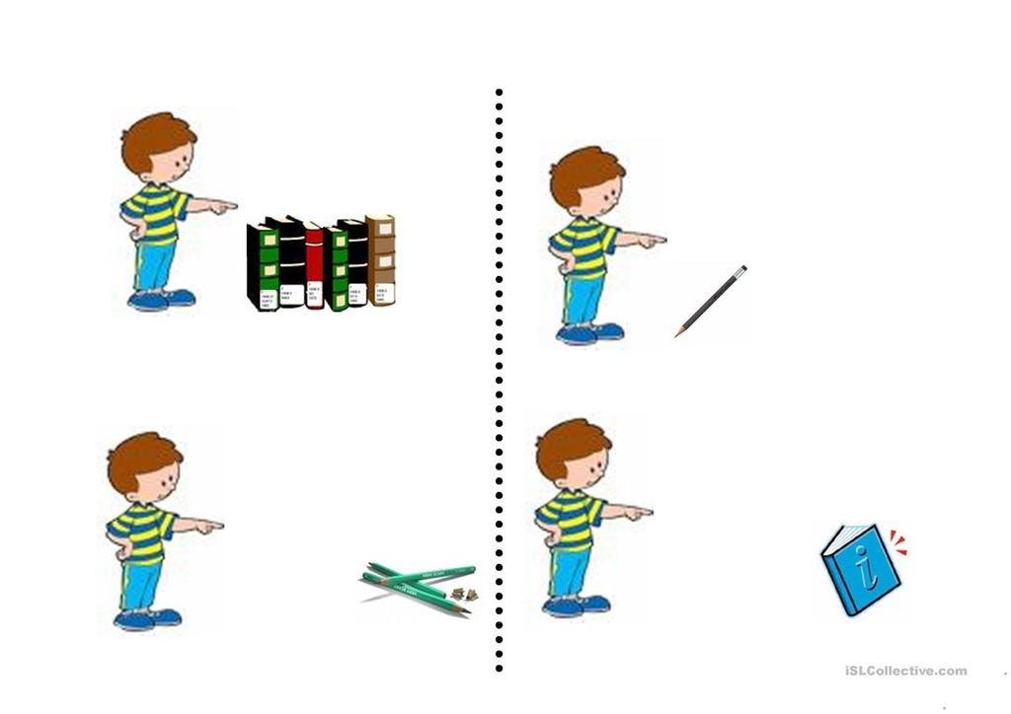
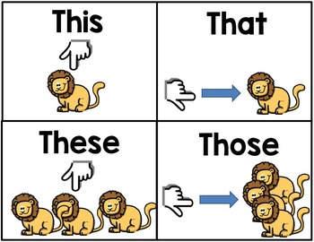


This
This (這)

Slide 4
當我們表達或說明遠距離的一個人或一件物件時，我們會用‘That is ... (那是…)’來表示。
* 所指的人或物的數量只有1,稱為Singular (單數)。

Slide 5
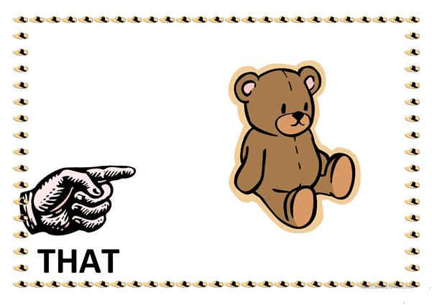
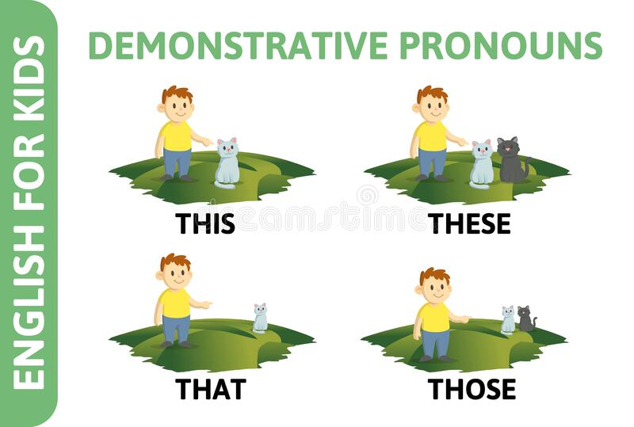
That (那)
That

Slide 6
當我們表達近距離的人或物件，且該數量多於1時，我們會用‘These are ... (這些是…)’來表示。
* 所指的人或物的數量多於1,稱為Plural(眾數)。
*當所指的人或物件數量多於1時，需注意在名詞後加上 ‘s /es /ies’ 以表示眾數。

Slide 7

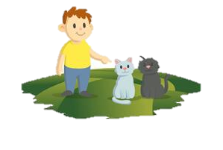
These (這些)
These

Slide 8
當我們表達遠距離的人或物件，且該數量多於1時，我們會用‘Those are ... (那些是…)’來表示。
* 所指的人或物的數量多於1,稱為Plural(眾數)。
*當所指的人或物件數量多於1時，需注意在名詞後加上 ‘s /es /ies’ 以表示眾數。

Slide 9
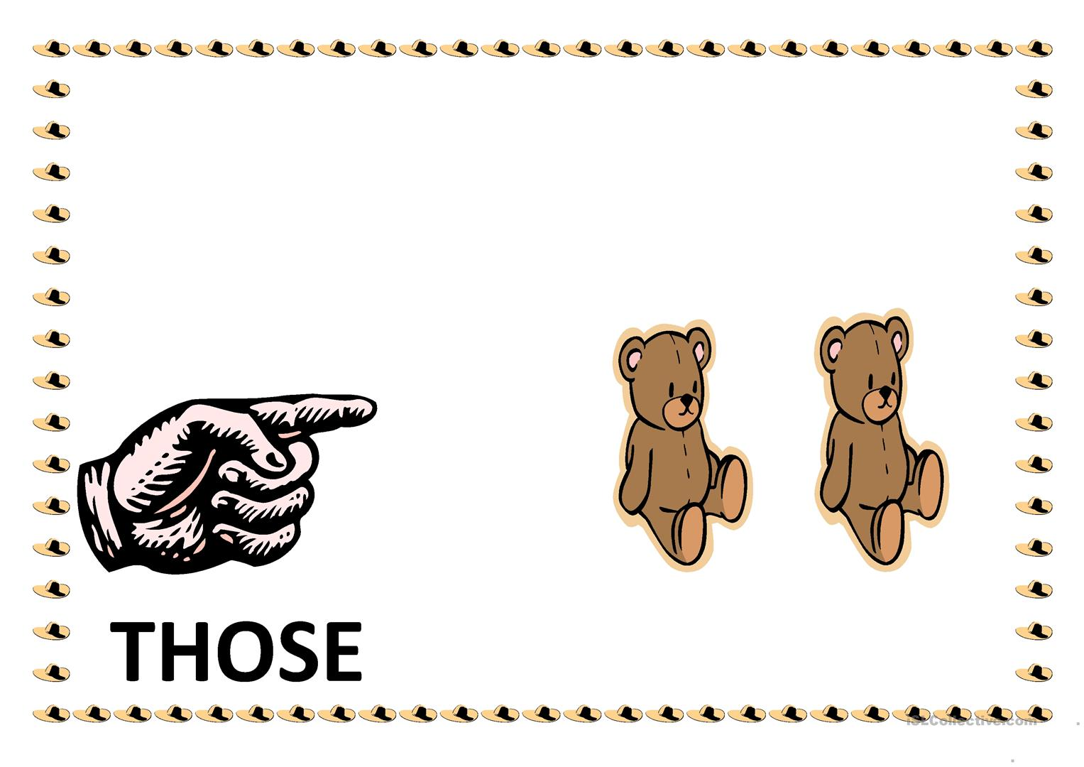
Those
(那些)
Those

Slide 10
用 ‘This is / These are’表示 near (近) 的東西。
用 ‘That is/ Those are’ 表示 far (遠) 的東西。
Singular
(單數)
Plural
(眾數)

Slide 11

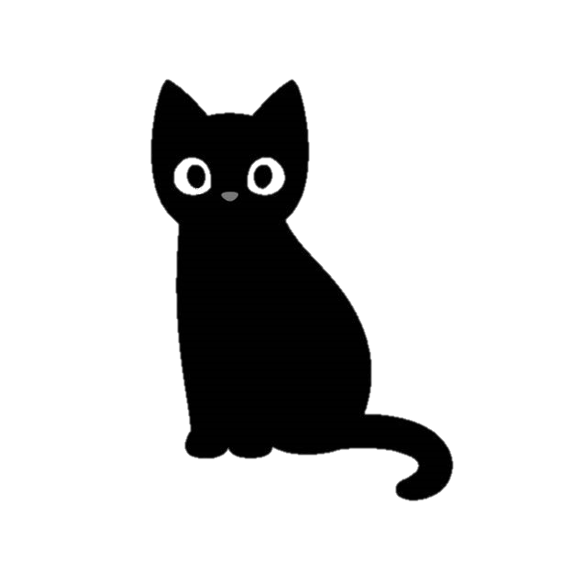
Exercise (請在紙上寫下正確答案，於24頁檢查答案。)
A. Read and circle the correct answer.
1. ( That / This ) is a black cat.

Slide 12

Exercise (請在紙上寫下正確答案，於25頁檢查答案。)
A. Read and circle the correct answer.
2. ( That / This ) is a red book.

Slide 13
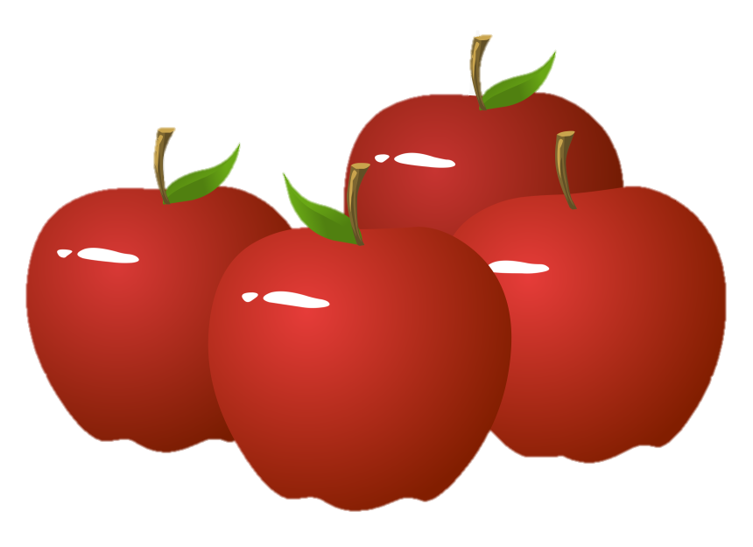
Exercise (請在紙上寫下正確答案，於26頁檢查答案。)
A. Read and circle the correct answer.
3. ( These / Those ) are apples.

Slide 14
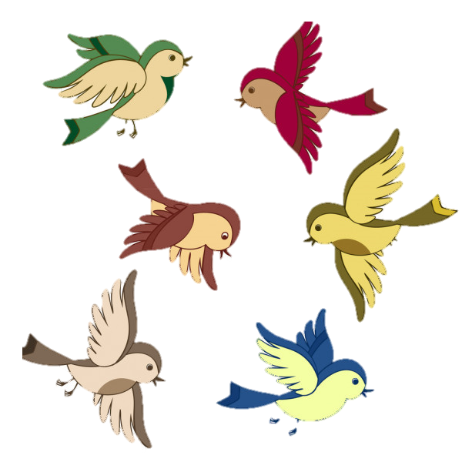
Exercise (請在紙上寫下正確答案，於27頁檢查答案。)
A. Read and circle the correct answer.
4. ( These / Those ) are birds.

Slide 15
Exercise (請在紙上寫下正確答案，於28頁檢查答案。)
B. Write This, That, These or Those.
________ is my classmate.
Her name is Kitty.

Slide 16

Exercise (請在紙上寫下正確答案，於28頁檢查答案。)
B. Write This, That, These or Those.
2. ________ bird is flying in the sky.

Slide 17
Exercise (請在紙上寫下正確答案，於30頁檢查答案。)
B. Write This, That, These or Those.
3. Mum! ________
flowers are for you.

Slide 18
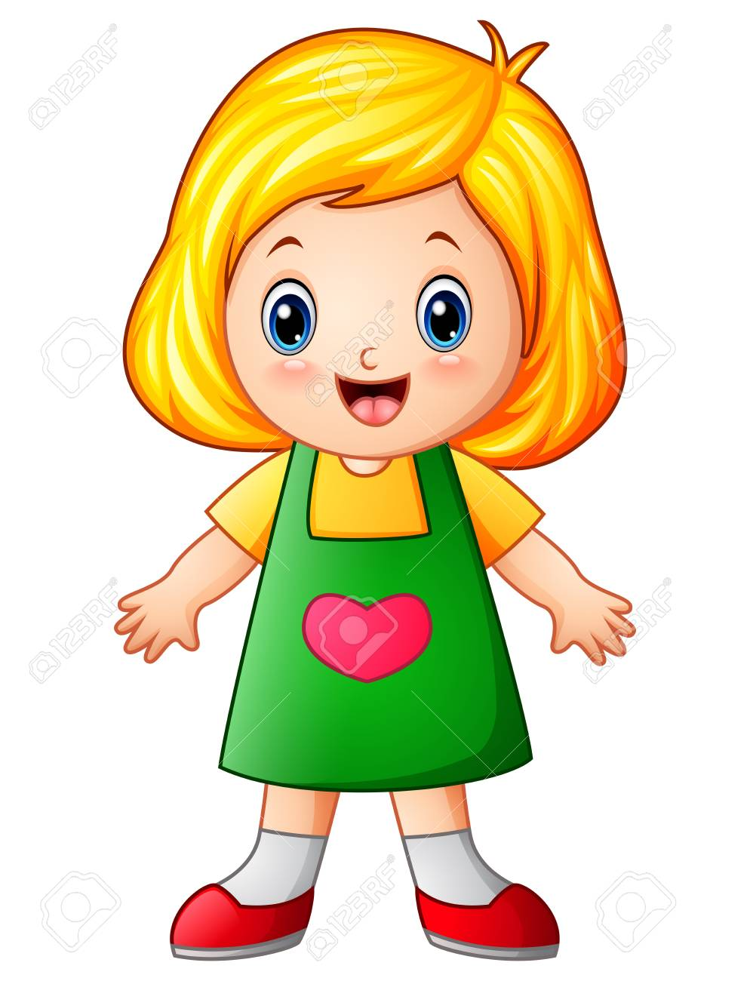
Exercise (請在紙上寫下正確答案，於31頁檢查答案。)
B. Write This, That, These or Those.
4. ________ rabbits are
lovely.

Slide 19
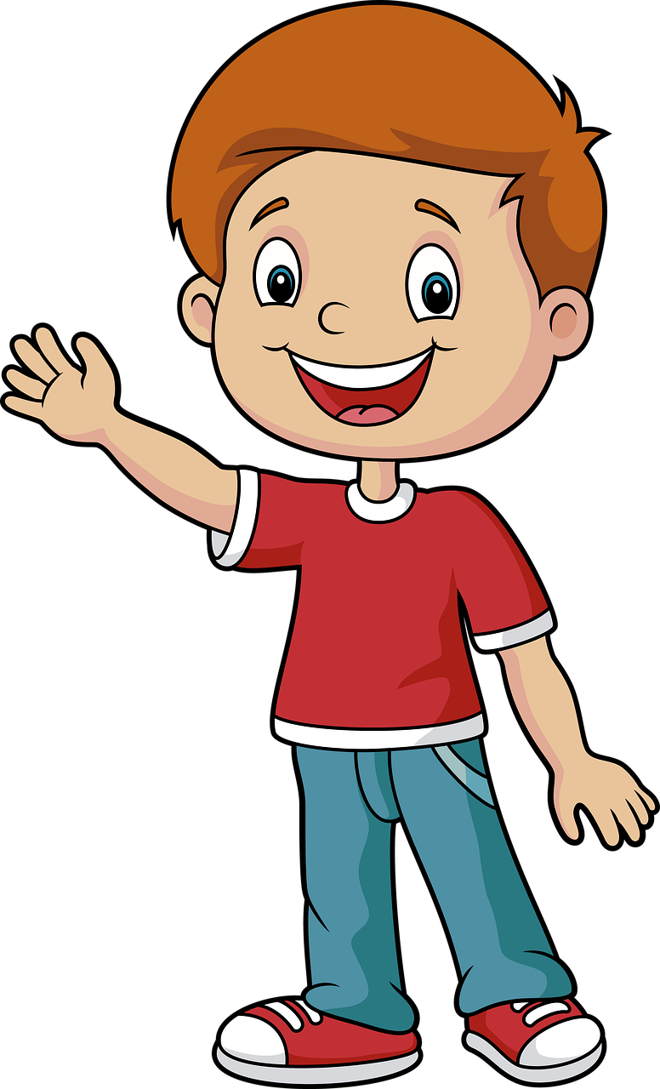
Exercise (請在紙上寫下正確答案，於32頁檢查答案。)
C. Write This is, That is, These are or Those are.
1. ____________ a little boy.

Slide 20
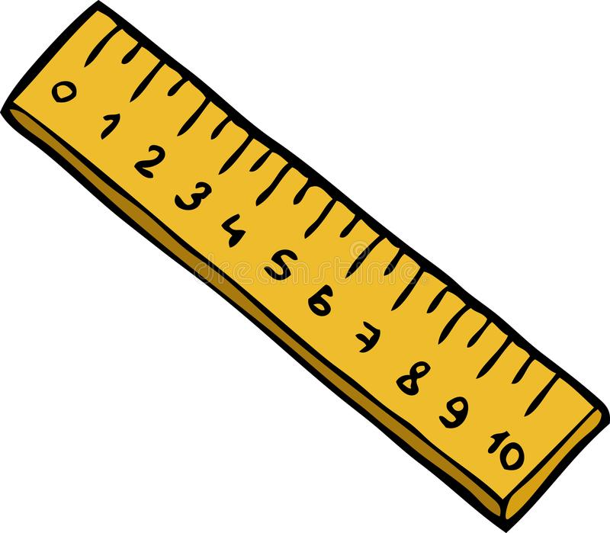
Exercise (請在紙上寫下正確答案，於33頁檢查答案。)
C. Write This is, That is, These are or Those are.
2. ____________ a yellow ruler.

Slide 21
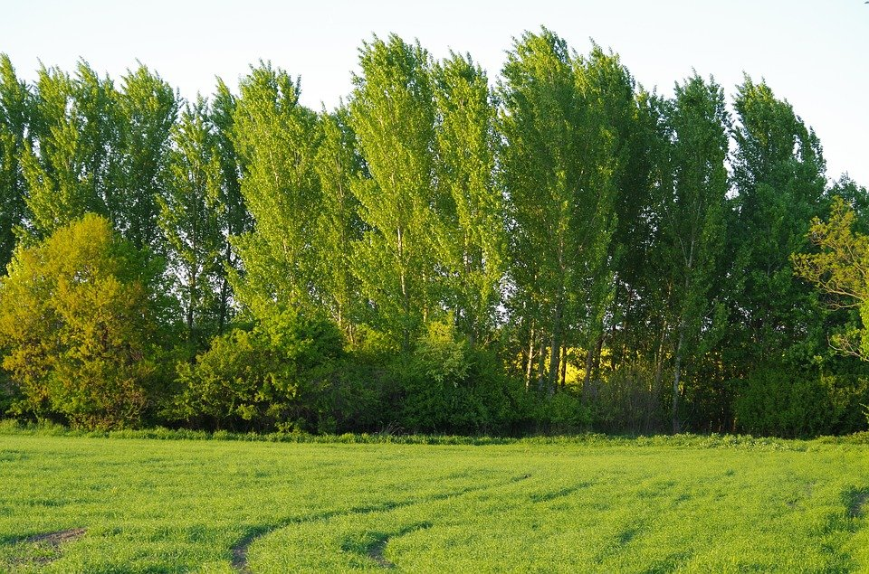
Exercise (請在紙上寫下正確答案，於34頁檢查答案。)
C. Write This is, That is, These are or Those are.
3. ____________ green trees and grass.

Slide 22
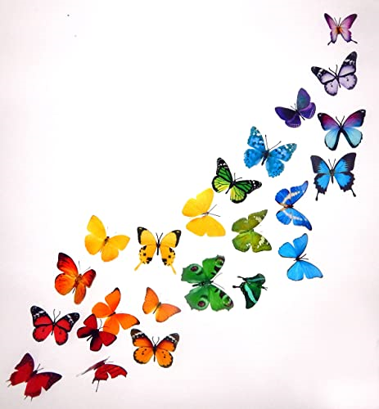
Exercise (請在紙上寫下正確答案，於35頁檢查答案。)
C. Write This is, That is, These are or Those are.
4. ____________ colourful butterflies.

Slide 23
答案版

Slide 24
Exercise
A. Read and circle the correct answer.
1. ( That / This ) is a black cat.

Slide 25
Exercise
A. Read and circle the correct answer.
2. ( That / This ) is a red book.

Slide 26
Exercise
A. Read and circle the correct answer.
3. ( These / Those ) are apples.

Slide 27
Exercise
A. Read and circle the correct answer.
4. ( These / Those ) are birds.

Slide 28
Exercise (請在紙上寫下正確答案，於28頁檢查答案。)
B. Write This, That, These or Those.
________ is my classmate.
Her name is Kitty.
This

Slide 29
Exercise (請在紙上寫下正確答案，於28頁檢查答案。)
B. Write This, That, These or Those.
2. ________ bird is flying in the sky.
That

Slide 30
Exercise (請在紙上寫下正確答案，於30頁檢查答案。)
B. Write This, That, These or Those.
3. Mum! ________
flowers are for you.
These

Slide 31
Exercise (請在紙上寫下正確答案，於31頁檢查答案。)
B. Write This, That, These or Those.
4. ________ rabbits are
lovely.
Those

Slide 32
Exercise (請在紙上寫下正確答案，於32頁檢查答案。)
C. Write This is, That is, These are or Those are.
This is
1. ____________ a little boy.

Slide 33
Exercise (請在紙上寫下正確答案，於33頁檢查答案。)
C. Write This is, That is, These are or Those are.
That is
2. ____________ a yellow ruler.

Slide 34
Exercise (請在紙上寫下正確答案，於34頁檢查答案。)
C. Write This is, That is, These are or Those are.
Those are
3. ____________ green trees and grass.

Slide 35
Exercise (請在紙上寫下正確答案，於35頁檢查答案。)
C. Write This is, That is, These are or Those are.
These are
4. ____________ colourful butterflies.

Slide 36

現在, 請完成Worksheet (5)。

